Slide 1
Transformations: Translation, Rotations, Reflection, and Deformations
By: Kevin Nash, Paul Harding, and Andrew Toth

Slide 2
A Transformation in Absolute Geometry is a function
(or mapping) ƒ that associates with each point P in some plane with some other point in that plane. This is then written as:
ƒ(P) = P’, such that
1) ƒ is one-to-one: If ƒ(P) = ƒ(Q), then P = Q,
2) ƒ is onto: Every point R in the plane has a pre-image under ƒ, that is, there exists a point S such that ƒ(S) = R.
Mapping three collinear points to three other collinear points is said to be Linear.

Slide 3
ƒ: { x’ = 2x +y +1
y’ = x + y + 2

Slide 4
Every function has an inverse ƒ⁻¹ such that:
ƒ⁻¹(P’) = P if and only if ƒ(P) = P’
Theorem- The inverse of a linear transformation is also, a linear transformation.
A transformation ƒ of the
plane is said to be A as a
Fixed Point if and only if:
ƒ(A) =A
A transformation of the plane
is called Identity Mapping if and
only if every point on the plane
is a fixed point. This
Transformation is denoted “e”

Slide 5
How do you find the inverse of this equation?
ƒ: { x’ = 2x +y +1
y’ = x + y + 2

Slide 6
Steps to finding the Inverse of a Transformation?
Solve the system for X and Y in terms of X’ and Y’
Combine the two equations and eliminate either the X or Y to
get one of the equation of the inverse
Substitute that equations into one of the equations from Step 1

Slide 7
ReflectionS
Suppose L is a fixed line is the perpendicular bisector of segment PP', for any point P in the plane, where P’= ƒ(P), then ƒ is a Reflection in the line L (where L is the Line of Reflection). We denote a reflection over line L by S_{L}.
If point C is always the midpoint of segment PP’ for all P, then ƒ is a reflection in point C, called the Center of Reflection, denoted by S_{C.}

Slide 8
Any mapping which preserves distances (and is therefore one-to-
one and a transformation) is called an Isometry (also motion,
rigid motion, or Euclidean motion).
ƒ is an isometry if and only if for each P and Q, with P' = ƒ(P) and Q' = ƒ (Q), then PQ = P'Q‘…
Proof: Let A', B', and C' be the images of points A, B, and C,
respectively, under a given distance-preserving transformation, and
suppose that A-B-C. Then AB + BC = AC. Since the mapping is
distance-preserving, A'B' + B'C' = A'C'. Therefore, A'-B'-C' (definition
of betweenness and the Triangle Inequality). Hence, betweenness and collinearity of any three points is preserved. Finally consider ∠ABC and ∆ A’B’C’. By SSS, ∆ ABC ≅ ∆ A'B'C'. Therefore,
∠ABC ≅ ∠A'B'C', and the angle measure is preserved.

Slide 9
ABCD Property: Reflections are angle-measure persevering betweenness preserving(B) , collinearity preserving (C), and distance preserving (D).
Given a triangle ∆ ABC in the plane, the counterclockwise
direction (the path (ABC)) is called the positive orientation of its vertices, with the clockwise direction (the path (ACB)) is the negative orientation.

Slide 10
Definition: A linear transformation of the plane is called Direct if and only if it
preserves the orientation of any triangle, and Opposite if and only if it reverses the
orientation of each triangle.

Slide 11
Do reflections preserve orientation?
Suppose ◊ ABCD is a quadrilateral that has been positively oriented.
Consider the image quadrilateral ◊A'B'C'D' under a line reflection with
axis 6, then under a point reflection with center L.
1. On your own paper, finish the construction of the image quadrilateral
◊ A'B'C'D' as carefully as you can in each case.
2. Look at the order of the image vertices, and decide whether the
orientation of the image is clockwise or counterclockwise in each case.
3. Did you detect any difference in the orientation-preserving properties
of two types of reflections?

Slide 13
Products of Two or More Reflections:
If ƒ and g are any two transformations, their product, denoted by gƒ, is just the ordinary functional composition g○ ƒ of ƒ and g . That is for each point P, gƒ(P) = g ○ ƒ(P) = g[ƒ(P)]. If ƒg ≠gƒ, we would say that ƒ and g do not commute.
Theorem 2: The product of an even number of opposite linear transformations is direct, and the product of an odd number is an opposite transformation.
Lemma: The product of and number of isometries
is an isometry.

Slide 14
A Translation in the plane is the product of two reflections translation
s_{m}, s_{L} where and are parallel lines. A Rotation is the product of two rotation reflections s_{m}s_{l} , where L and M are lines that meet, and the point of intersection is called the Center of the rotation
When rotating object, rotation about the origin is given in the equation R_{α}(x,y) = (x’,y’) where α is the angle, and:
X’ = Xcos(α) – ysin(α)
Y’ = Xsin(α) + Ycos(α)
The equation of a roation about a point (h,k) is

Slide 15
Fundamental Theorem on Isometries: Every isometry in the plane is the product of at most 3 reflections, exactly two if that isometry is direct and not the identity.

Slide 16
Glide Reflections
A Glide Reflection is the product of a reflection, s_{L,} and a translation, t_{ab} in a direction parallel to the line of reflection ( the line AB || L)
Any glide reflection g = s_{L} t_{ab} is the product of three line reflections, Since a translation itself is the product of two line reflections, which Are both perpendicular to L.

Slide 17
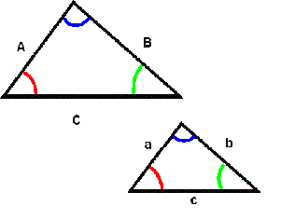
Similitude and Dilations
A Similitude or Similarity Transformation, is a linear transformation S such that
for some positive constant k,
P’Q’ = kPQ
For all pairs of points P, Q and their image P’ = s(P) and Q’ = s(Q). The number k
is called the Dilation Factor for the similitude.
Do these two triangles form a Similitude?
If so, how can you tell?

Slide 18
Theorem 1: A similitude is angle preserving; if A, B, and C are any three points in the plane and A’, B’, and C’ are there images under a similitude, then ∠ A’B’C’ ≅∠ABC
A Dilation² with center O and Dilation Factor k>0 is that transformation d_{k} that leaves O fixed and maps any other point P to that point P’ on the ray OP such that OP’ = k*OP.
Two configurations are said to be homothetic if and only if one is the image of the other under some dilation map.

Slide 19
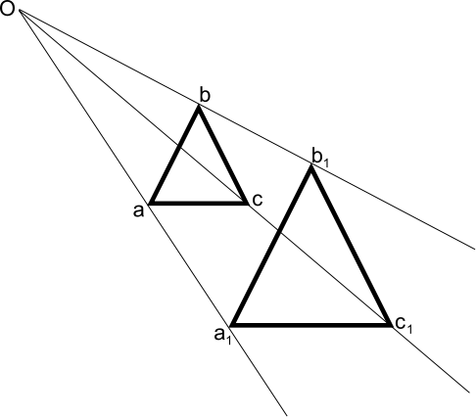

Slide 20
Theorem 2: Any dilation is a similitude, and has the ABC property.
Theorem 3: Given any two similar triangles ∆ ABC and ∆ PQR, there
Exists a unique similitude that maps the first triangle onto the second.
A Linear Transformation is a transformation that preserves only
Betweeness and collinearity. This is also known as the BC Property.
Theorem: A linear transformation maps a parallel lines to parallel lines.

